Slide 1

Exam Papers
Username
Password
LOGIN

Slide 2
Module leader view

Slide 3

Exam Papers
Logged in as <Username>(Module Leader)
Upload new
My Papers
CSC 3123 Web Technologies
Paper 1
Paper 2
Paper 3
CSC 3221 Programming For Games
CSC 3223 Graphics For Games

Slide 4
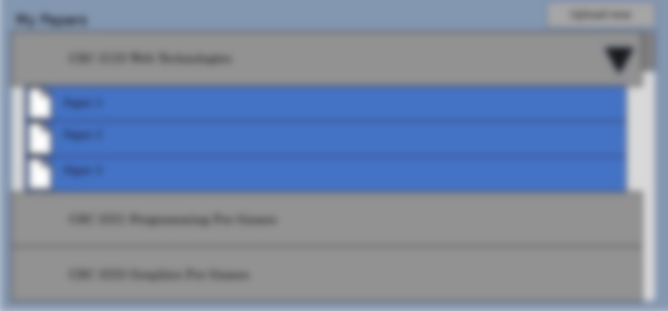
Exam Papers
Logged in as <Username>(Module Leader)
Upload new
My Papers
Upload Papers
CSC 3123 Web Technologies
Paper 1
File
Paper 2
Paper Name
Module
Paper 3
CSC 3221 Programming For Games
SUBMIT
CSC 3223 Graphics For Games

Slide 5
External Examiners view

Slide 6
Exam Papers
Logged in as <Username>(Examiner)
Upload new
My Papers
CSC 3123 Web Technologies
Paper 1
Comment
Paper 2
Comment
Paper 3
Comment
CSC 3221 Programming For Games
CSC 3223 Graphics For Games

Slide 7
Exam Papers
Logged in as <Username>(Examiner)
Upload new
My Papers
Paper 1 Comments
CSC 3123 Web Technologies
Comments
Paper 1
Paper 2
Paper 3
CSC 3221 Programming For Games
ADD
CSC 3223 Graphics For Games

Slide 8
Student View

Slide 9
Exam Papers
Logged in as <Username>(Student)
Upload new
My Papers
CSC 3123 Web Technologies
Past Paper 1
Past Paper 2
Past Paper 3
CSC 3221 Programming For Games
CSC 3223 Graphics For Games

Slide 10
Admin View

Slide 11
Exam Papers
Logged in as <Username>(Administrator)
Add Module
My Papers
CSC 3123 Web Technologies
Paper 1
Configure
Paper 2
Configure
Paper 3
Configure
CSC 3221 Programming For Games
CSC 3223 Graphics For Games

Slide 12
Exam Papers
Logged in as <Username>(Administrator)
Upload new
My Papers
Add Module
CSC 3123 Web Technologies
Module Title
Paper 1
Module Leader
Paper 2
External Examiner
Paper 3
CSC 3221 Programming For Games
SUBMIT
CSC 3223 Graphics For Games

Slide 13
Exam Papers
Logged in as <Username>(Administrator)
Upload new
My Papers
Paper 1
CSC 3123 Web Technologies
Set Due Date
Paper 1
Add Checkers
Paper 2
Paper 3
CSC 3221 Programming For Games
SUBMIT
CSC 3223 Graphics For Games

